Slide 1
Initiative & Follow Through
What is it?
Do I have it?
Can I develop it?

Slide 2
Activity: Sketchpad
What Does Taking Initiative Look Like To You?
Please have the students use their computer to access a digital drawing tool. In our example we used: https://sketch.io/sketchpad/
Have the students take approximately 5-10 minutes to draw an image that represents Taking Initiative & Following Through

Slide 3
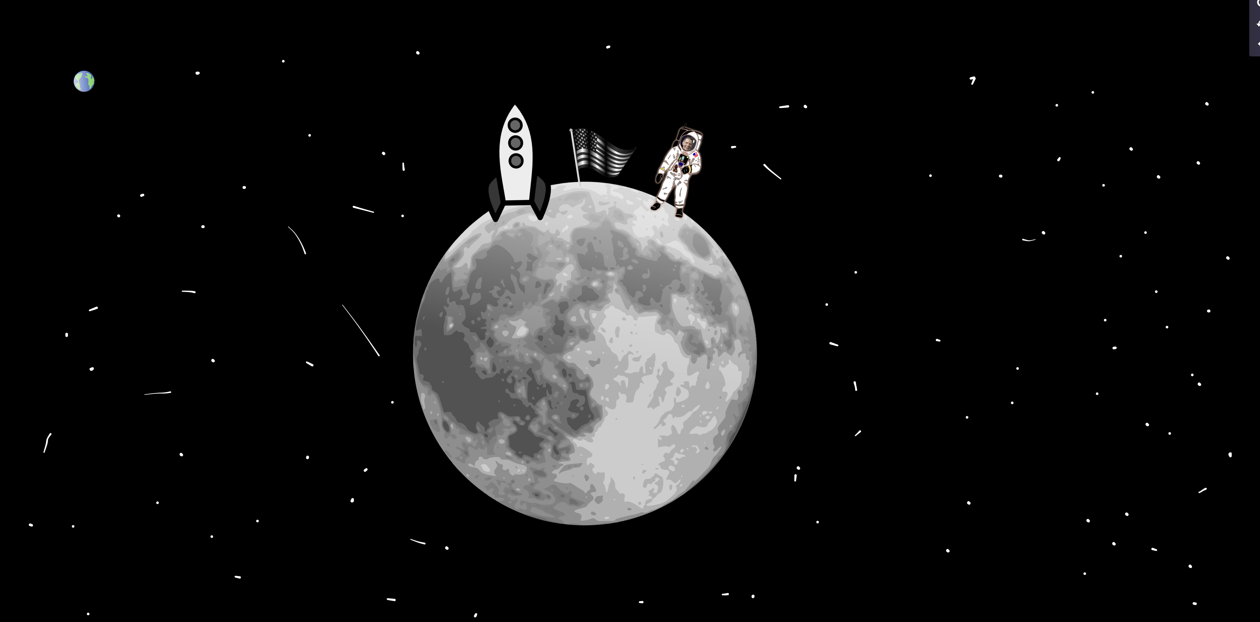
Activity: Sketchpad
What Does Taking Initiative Look Like To You?
Example
we created a picture of the moon landing as a representation of taking initiative and following through

Slide 4
What is it?
Initiative and Follow Through is taking charge of a situation either individually to fill a need or motivating others to take action. Completing tasks without having to be followed-up with or reminded and can be relied upon and trusted to carry out commitments.*
What does having initiative and following through mean to you? (describe your artwork)
Can you think of some ways to develop either initiative or follow-through?
*Source: Roger C. Stewart Leadership and Professional Development Department, https://www.purdue.edu/vpsl/leadership/myExperience/Competencies_List.html

